Slide 1
Money Crop
Team : Rashqe-Qamar
College : MNNIT , Allahabad

Slide 2
What is Money Crop ?
Money Crop is a decentralized web app based on blockchain technology which addressed the problem of corruption in intermediary stages of Supply Chain in Food and Agricultural Sector.
It focuses on making farmers get the optimal profits without intermediary losses.

Slide 3
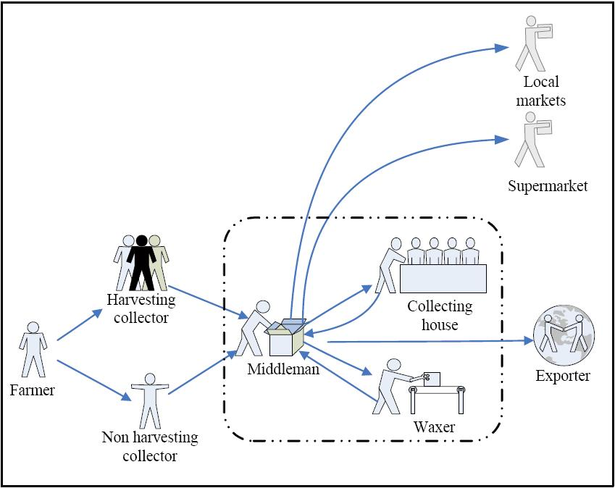
Current System

Slide 4
Current Scenario :
The UN Reports that up to 50% of crop value vanishes between harvest and point of sale.
“The middleman” takes away most of the profits leaving absolutely nothing for farmers.
Problem is of importance in countries with high corruption like India

Slide 5
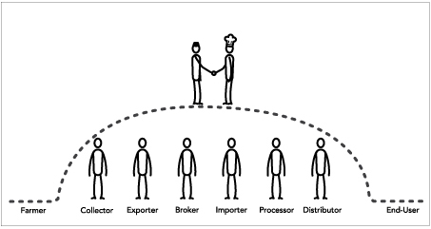
Proposed System

Slide 6
Why blockchain ?
Decentralized thus no scope of central authority
Cryptographically Secure i.e data is hashed and is safe from attacks.
It is immutable - Data cannot be manipulated for benefits or corruption
Fast and Reliable source - One Stop

Slide 7
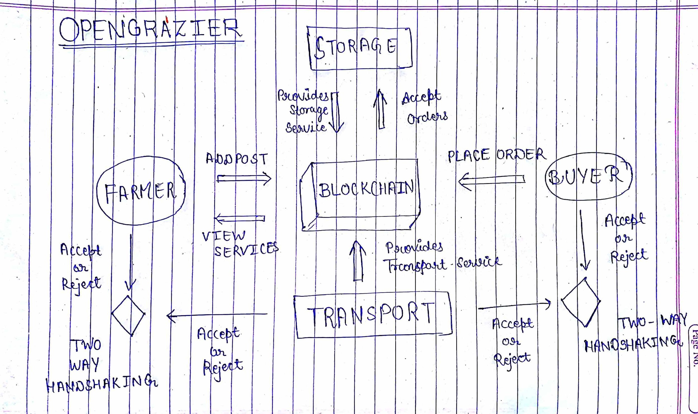
Flow-Chart Model

Slide 8
Advantages of Money Crop
Provides them with mobile finance
Digital Identity
Increase farmer income
Access to new products and services
Empowerment of small farmers
A better life for families and local community.

Slide 9
Thank You

